Slide 1
REPORT JUICING LEARNING LAB
University of Washington (Seattle) | May 23
Mohammed Kanani, MS
Yee Ng, MD
Nathan Cross, MD, MS, CIIP

Slide 2
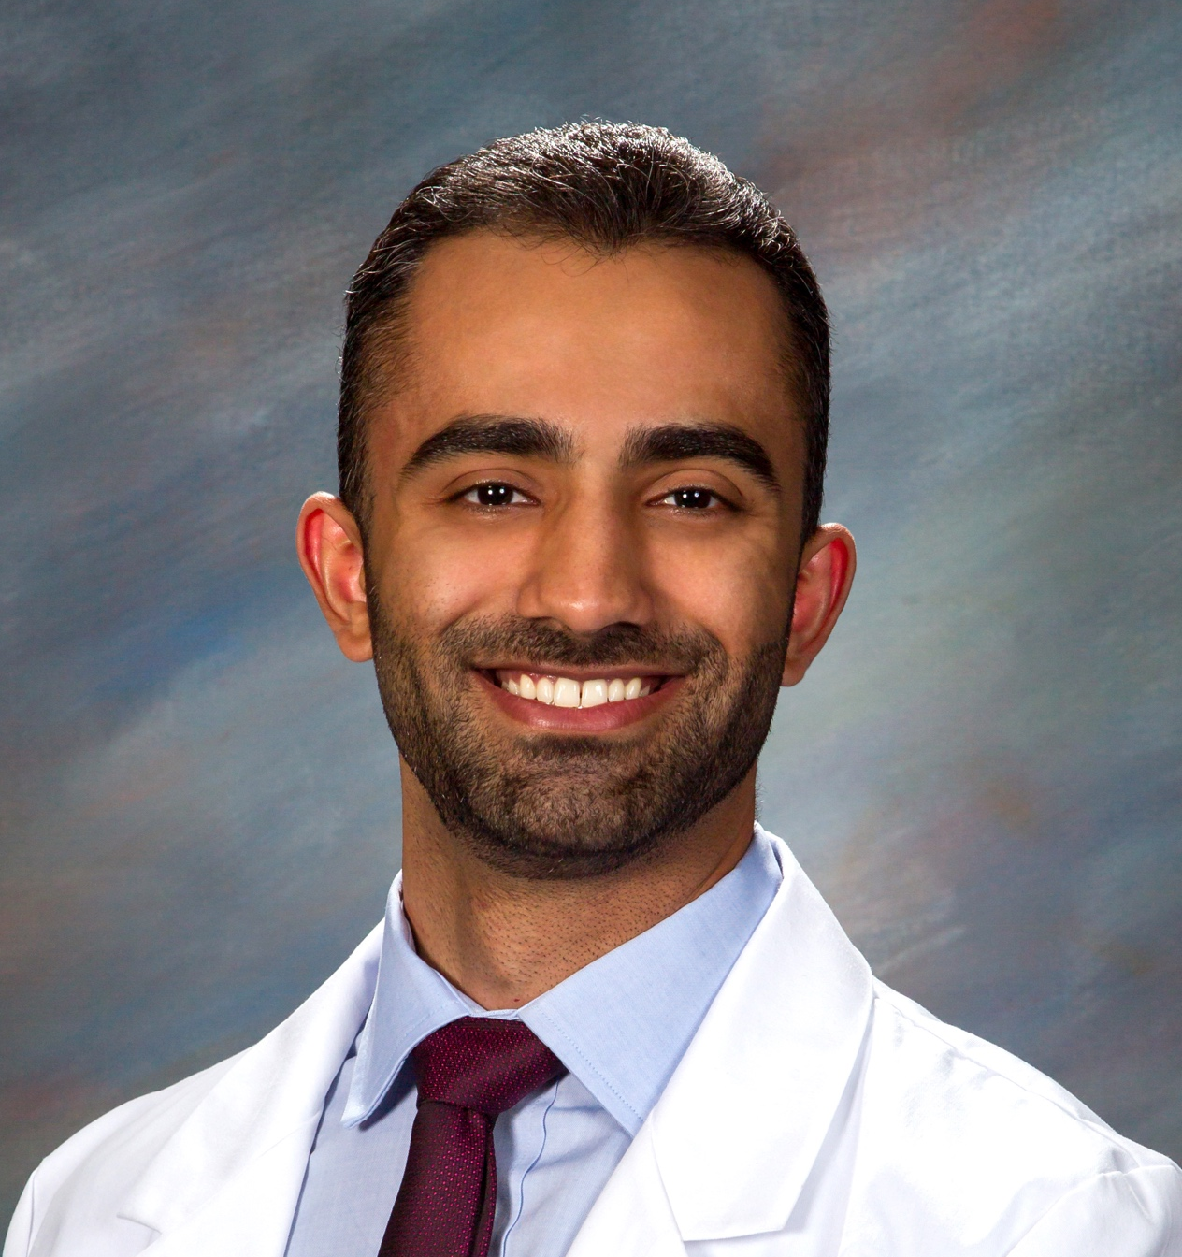
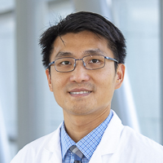
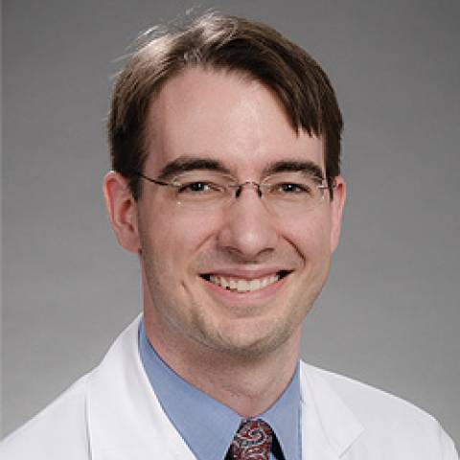
Mohammed Kanani MS
Medical Student
mkanani@uw.edu
Yee Ng MD
Abdominal Imaging
Director of Clinical AI
yeeng@uw.ed
Nathan Cross MD MS
Neuroradiologist
VC of Informatics
nmcross@uw.edu

Slide 3
No financial interest or affiliation concerning material in this presentation will be discussed.
No non-FDA approved or investigational medical services/devices will be discussed.

Slide 4

PLEASE, before using any of these tools with patient data understand:
your local AI governance
Model and where it is hosted
Where your data is going
Compliance and IRB restrictions

Slide 5
FINDINGS: NECK Contrast-enhanced images of the neck show no obvious injury to bilateral carotid and bilateral vertebral arteries. If there is concern for a vascular injury in the neck, reconstruction of this scan range as a formal CTA Neck with a dedicated interpretation should be requested. CHEST Heart, aorta, and great vessels: There are pulmonary emboli involving the right main pulmonary artery bifurcation with extension into the upper and lower lobar and distal branches. A few small segmental and subsegmental left lower lobe pulmonary emboli are also seen (series 500, images 213 and 224). RV LV ratio remains less than 1, although there is slight dilation of the main pulmonary artery at 32 mm, and enlargement of the right atrium. Mediastinal hematoma: Absent Pericardial fluid: Absent Endotracheal tube: Present, approximately 2.8 cm from the carina. Intercostal tubes: Absent. Right lung: Basilar atelectasis. Left lung: Basilar atelectasis. Right pneumothorax: Absent. Left pneumothorax: Absent. Right pleural fluid: Absent. Left pleural fluid: Absent ABDOMEN AND PELVIS Liver: A small laceration is identified within hepatic segment 5, which measures approximately 2.3 cm in depth and measures approximately 2 cm in length. A 1.5 cm hepatic hypodensity is identified with a tiny peripheral punctate focus of arterial hyperenhancement, which demonstrates progressive fill-in on venous images is compatible with a simple hepatic hemangioma (example series 9, image 79 and series 8, image 76). Mild periportal edema is present, likely secondary to volume resuscitation. Portal veins: Normal. Gallbladder and bile ducts: Normal Spleen: Normal Pancreas: Normal Right Kidney: Surgically absent with postoperative changes in the right renal fossa. Left Kidney: No discrete traumatic injury. Broad products seen within the left retroperitoneal space are favored secondary to redistribution. Adrenal glands: Normal Aorta and IVC: Normal Stomach, duodenum and small bowel: Enteric tube tip and side-port terminate within the gastric antrum. The stomach and small bowel are unremarkable in course and morphology. Colon: The colon is unremarkable in course and morphology. Normal appendix. Free intraperitoneal air or fluid: Expected pneumoperitoneum. Mesentery, omentum, and retroperitoneum: Right nephrectomy changes. Blood products are seen within the bilateral retroperitoneal spaces, likely secondary to redistribution given delayed images. Right abdominal drain noted. Lymph Nodes: No enlarged lymph nodes by CT size criteria. Bladder: Bladder catheter in place with nondependent air. Pelvis organs: Normal. BODY WALL & SOFT TISSUES: Projectile tract entry is seen along the right posterolateral flank, progressing inferomedially through the right psoas muscle, bilateral L1-L2 neural foramen, left psoas muscle, and terminating within the subcutaneous soft tissues of the left flank. Of important note, the projectile tract crosses the spinal canal, with punctate projectile fragment seen within the canal. Midline laparotomy and right nephrectomy changes. BONES: Small chip fractures involving the right posterolateral corner of the L1 vertebral body and left L1 pars interarticularis secondary to projectile injury as above. No additional fracture seen. Approximately 50% height loss of the L3 vertebral body similar to prior radiographs. Sternum: Normal See accompanying CT of the Spine for a description of full spine evaluation. IMPRESSION: 1. Projectile injury to the right posterolateral flank with resultant AAST grade 2 liver laceration, and reported high-grade right renal injury status post nephrectomy, as well as presumed spinal cord injury, with termination projectile within the left flank soft tissues. 2. Bilateral pulmonary embolism as described above, right more than left. There are findings suggestive of early right heart strain with dilation of the main pulmonary artery and right atrial enlargement, although RV LV ratio remains less than 1. Preliminary findings were briefly reviewed with Dr. Gandalf the Grey at the CT scanner by Dr. Boromir Son of Denethor II at 0d ago 0300 AM. I have personally reviewed the images and agree with the report (or as edited).
{
"isFracture":true,
"isAcute":false,
"heightLoss":"50%"
}

Slide 6
Purpose
Radiology reporting is largely unstructured​
To understand it, need NLP​
Local vs API​
Both are useful​
Local​
No data use agreement (DUA), business associate agreement (BAA)​
Other than machine/GPU purchase and electricity, no further fees​
May be more acceptable to your AI/IT/Compliance governance​
Reproducible – vendors sometimes change API-based models or security around models altering your results

Slide 7
Outline
Overview of Large Language Models (15min)
Prompt Engineering Strategies (8 min)
Model Performance (8 min)
Software Frameworks​ (8 min)
Advanced Concepts​ (10min)
Demonstration (30min)
Quick Challenge (20min)
Questions (10min)

Slide 8
Lets get the demo env cooking

Slide 9
OVERVIEW OF LARGE LANGUAGE MODELS

Slide 10
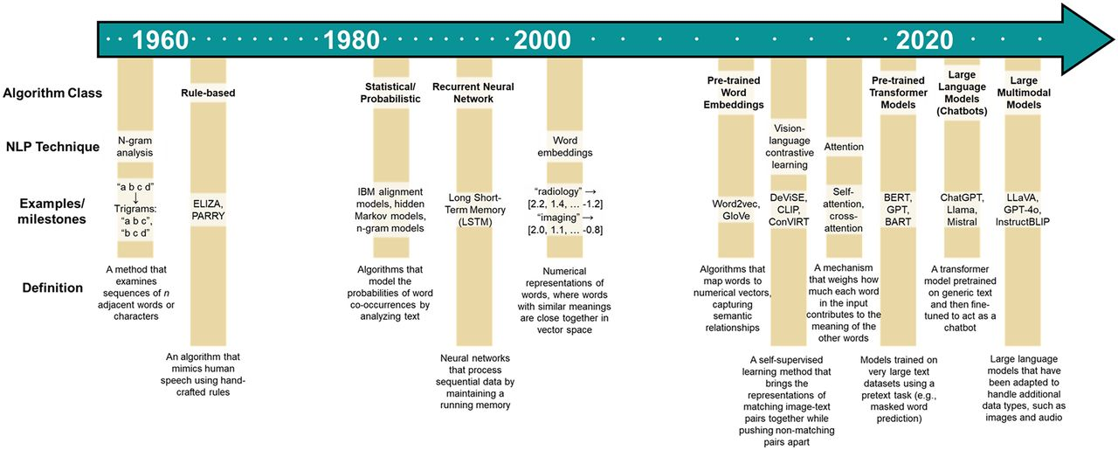
Evolution of NLP
AI/Deep Learning

Slide 11
Sequential
A cat goes for a walk.

Slide 12
Un
chat
se
promène
RNN
RNN
RNN
RNN
RNN
RNN
RNN
RNN
RNN
RNN
RNN
RNN
A
cat
goes
for
a
walk

Slide 13
Attention
A cat goes for a walk.

Slide 14
Un chat se promène
Decoder
cat
walk
A
goes
for
a
Encoder
A
cat
goes
for
a
walk

Slide 15
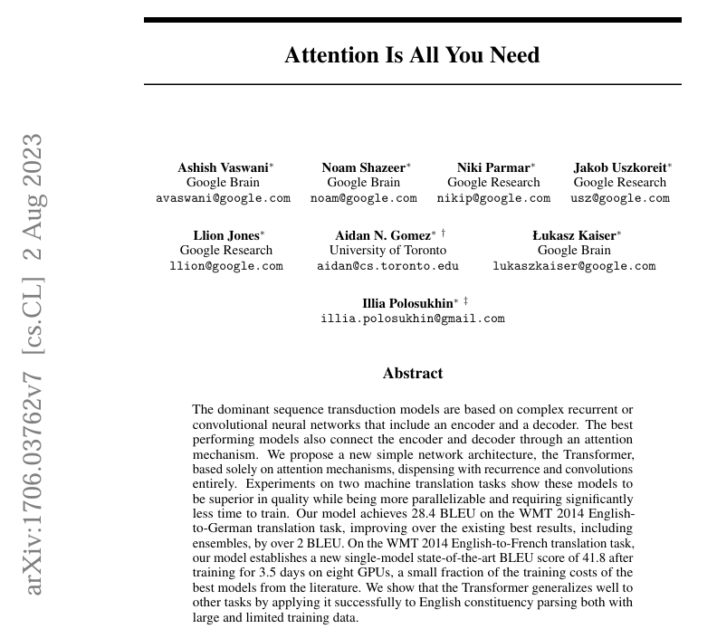
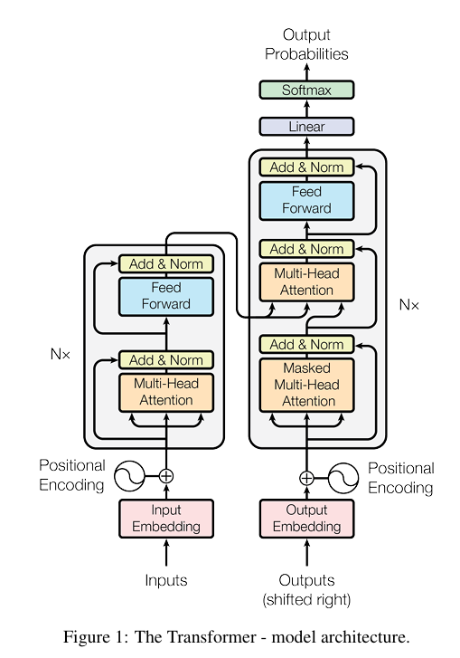


Slide 16
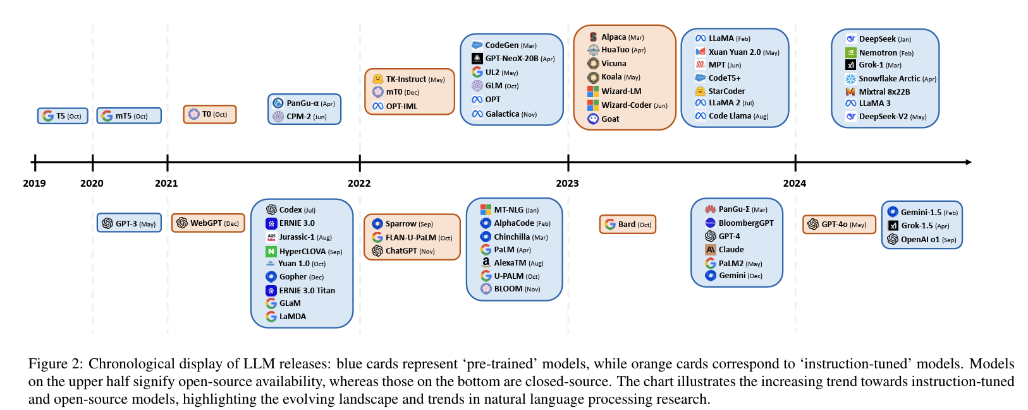
Naveed et al., 2023 (arXiv:2307.06435)​

Slide 17
Types of Language Modeling
Conventional Language Models (CLMs) | Pretrained Language Models (PLMs) | Large Language Models (LLMs)
Trains task-specific models in supervised settings | Trained self-supervised setting on a large corpus of text​ Learns a generic representation that is shareable among various NLP tasks​ Tens of billions parameters​ | Zero-shot transferable to downstream tasks without fine-tuning​ Accurately respond to task queries when prompted task descriptions and examples​ Hundreds of billions parameters

Slide 18
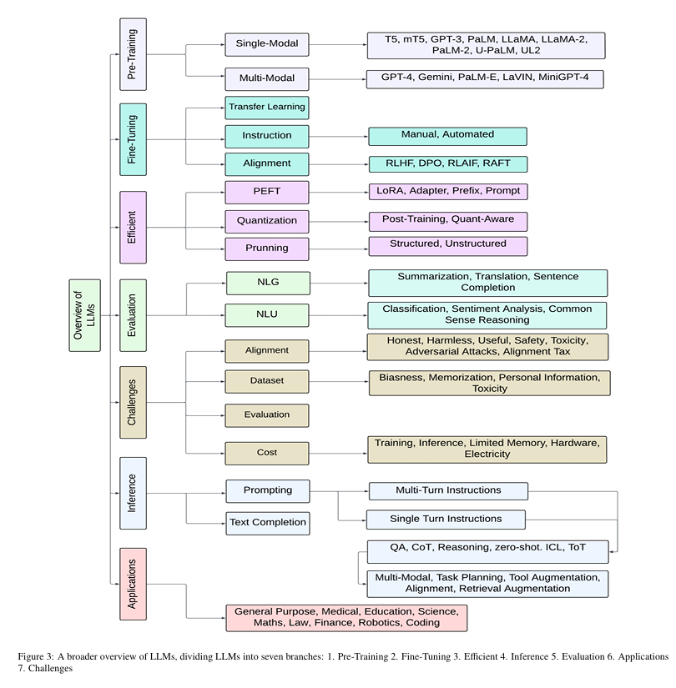
Naveed et al., 2023 (arXiv:2307.06435)​

Slide 19

OpenAI​
Context window: 128000 tokens​
Proprietary​
Input: Multimodal​
Output: Multimodal​
Competitive in:
Reasoning
Knowledge
Science
Math
Coding​
GPT-4-Turbo
Excellent processing power
GPT-4o
Ability to complete complex, multistep tasks
GPT-4o mini
Cheaper ($0.15/million vs. $2.50)
Solves complex scientific and math problems
More accurate and less prone to hallucinations
128,000 tokens and an output limit of 4,096 tokens.
Improved data extraction, classification, verbal reasoning
128,000 tokens and an output limit of 16384 tokens.
Less accurate.
GPT 4.5
Latest advancement
Last “non-chain of thought”
Enhanced processing capabilities while maintaining faster response times than the o-series.

Slide 20

Google DeepMind​
Context window: 1 million tokens​
Proprietary​
Input: Multimodal​
Output: Text​
Gemma 3
(1B, 4B, 12B, 27B)
Upgrade to Gemma 2
RecurrentGemma
(2B, 9B)
Griffin-based, instead of Transformer-based.
PaliGemma
(3B)
Vision-language model that takes text and image inputs, and outputs text
PaliGemma 2
(3B, 10B, 28B)
Upgrade to PaliGemma
Multilingual capability (supports 140 languages)
Longer context length (128k tokens)
Multimodality + function calling.​
Capable of more vision-language tasks
Made by connecting a SigLIP image encoder with a Gemma language model.

Slide 21

Meta AI (Facebook)
Context window: 128000 tokens​
Open source!​!!
Input: Text​
Output: Text​
Llama 3
(8B, 70B, 405B)
Collection of pretrained and fine-tuned text models
Llama 3.2
Collection of pretrained and instruction-tuned generative models
Llama 3.2 vision
(11B, 90B)
Multimodal LLMs
Llama 3.3 (70B)
Text only instruct-tuned model
Sizes from 8 billion to 405 billion parameters
Pre-trained on ~15 trillion tokens.
1B and 3B sizes (text in/text out).
70B size (text in/text out).

Slide 22

Microsoft
Context window: 128000 tokens​
Open source!​!!
Input: Text​
Output: Text​
Small, efficient models, trained on high quality data​
Phi-4
(14B)
Rigorous enhancement and alignment process
Phi-4 mini (3.8B)
Lightweight
Incorporating both supervised fine-tuning and direct preference optimization to ensure precise instruction adherence and robust safety measures
Built upon synthetic data with a focus on high-quality, reasoning dense data further finetuned for more advanced math reasoning capabilities

Slide 23

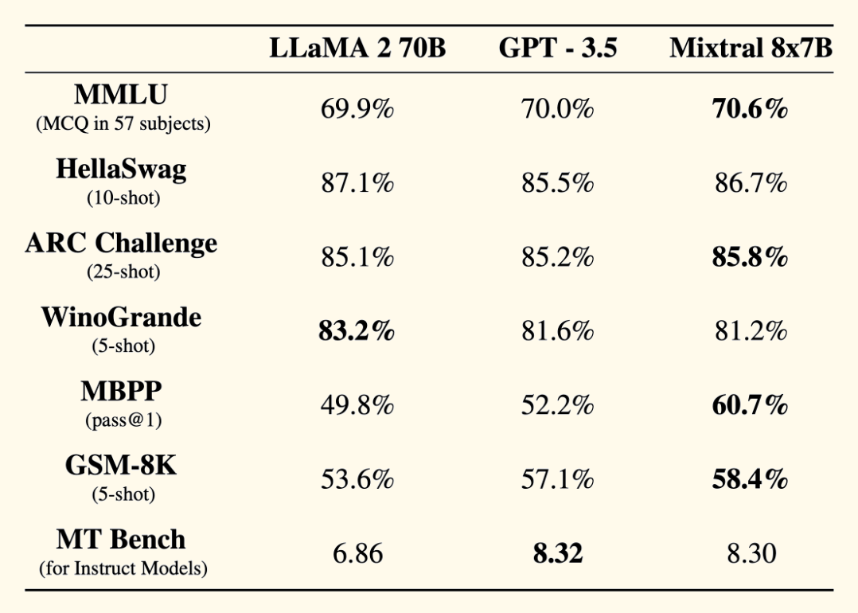
Mistral AI
Context window: 256k tokens​
Open source!​!!
Input: Multimodal
Output: Text​
open source commitment, yet high performance with efficient architecture
Mistral Instruct 7B
Mixtral 8x 7B
Sliding window attention instead of multi-head attention
Sparse mixture-of-experts network
Picks from a set of 8 distinct groups of "experts"
46.7B parameters but only uses ¼ of them per token

Slide 24
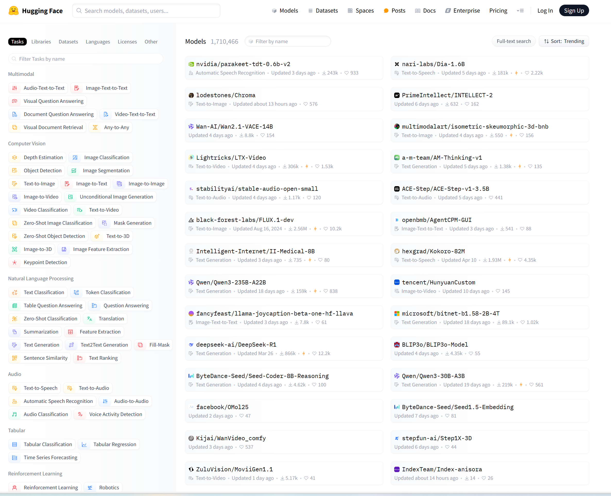
library

Slide 25
PROMPT ENGINEERING

Slide 26
Why Use LLMs for Radiology Reports?
Radiology reports are unstructured, narrative text.​
Clinically important findings (like compression fractures) may be buried in long paragraphs.​
LLMs can help automate extraction of:​
Diagnoses​
Anatomical locations​
Severity​
Clinical recommendations​

Slide 27
Zero-shot Prompting​
What it does: Directly asks the model to perform a task with no examples.​
Best for: Simple extractions or well-understood tasks.​
Example Prompt:​
“Identify any compression fractures in this report:​ 'There is mild wedging of T12 with loss of height.’”​
→ {"fracture": "present"}
​
Few-shot Prompting​
What it does: Gives a few labeled examples to teach the format and logic.​
Best for: Clinical language with variation in phrasing or format.​
Example Prompt:​
Extract compression fracture findings:​
Report: "Mild compression deformity of L1. Chronic."
→ {"fracture": "present"}
Report: "Severe collapse of T11. Acute." ​
→ {"fracture": "present"}
Now extract from:​
"Moderate compression of L2 with subacute features."​
→

Slide 28
Chain-of-thought (CoT) Prompting
What it does: Guides the model to reason through each step before answering
Best for: Ambiguous, multi-layered reports.
Example Prompt:​
Report: "There is anterior wedging of L2 with loss of height."​
Step-by-step:​
1. Identify vertebral level → L2 ​
2. Recognize deformity → Wedging = compression ​
3. Assess severity → Not explicitly stated; assume mild ​
​ → {"fracture": "present"}
​
Instruction Prompting​
What it does: Gives a clear directive with output format (e.g., JSON)
Best for: Structured data extraction
Example Prompt:​
“Extract compression fracture findings in this format:​
{"fracture": "", "level": "", "severity": "", "acuity": ""}​
Report: 'Compression fracture at T10, likely chronic.’”
→ {"fracture": "present", "level": "L2", "severity": "mild", "acuity": ”chronic"}

Slide 29
Self-consistency (CoT) Prompting
What it does: Runs multiple CoT generations and picks the most consistent answer
Best for: Handling vague or uncertain language.
Example Prompt:​
Run 5 prompts for:
'Possible mild collapse of T12 with chronic features.’
​
Final answer = most consistent result
→ {"fracture": "present"}
​
Radiology Report
Chain-of-thought 1
Chain-of-thought 4
Chain-of-thought 5
Absent
Chain-of-thought 2
Chain-of-thought 3
Present
Present
Absent
Present
3/5 → {"fracture": "present"}

Slide 30
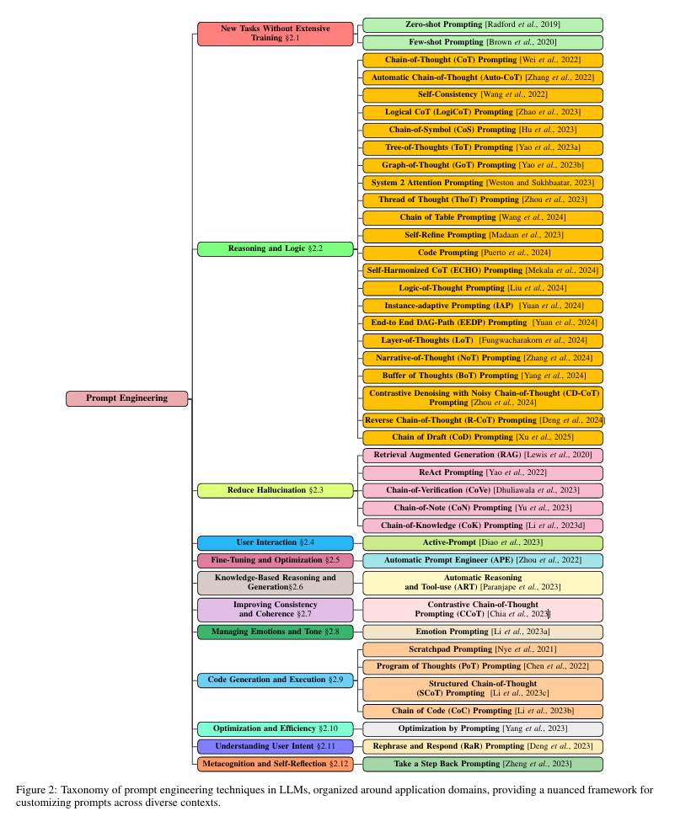
Sahoo et al., 2023 (arXiv:2402.07927v2)​

Slide 31
Retrieval-Augmented Generation (RAG)
LLM + External Search​
Fetch relevant data (e.g., guidelines, prior exams)​
Generate more accurate, grounded output​
Used to:​
Handle rare/complex phrasing​
Ground reasoning in clinical context​
Improve robustness and explainability
Scenario​ | RAG Role​
"Wedge loss of height at L2"​ | Retrieve synonyms/labeling standards​
"Compression deformity, uncertain age"​ | Retrieve prior reports for comparison​
"Multiple old fractures"​ | Retrieve full report history​
“Mild anterior wedging"​ | Retrieve severity criteria​

Slide 32
MODEL PERFORMANCE

Slide 33
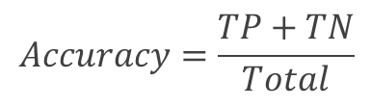
​ | ​ | User Annotation (Ground Truth)​ |  | ​
​ | ​ | Fracture​ ⊕​ | No Fracture​ ⊖​ | ​
LLM Output​ | Fracture​ ⊕​ | True Positive (TP)​ | False Positive (FP)​ | Positive Predictive Value/Precision (PPV)​ ​
 | No Fracture​ ⊖​ | False Negative (FN)​ | True Negative (TN)​ | Negative Predictive Value (NPV)​ ​
​ | ​ | Sensitivity/Recall​ ​ | Specificity​ ​ | ​
$$Accuracy=\frac{TP+TN}{Total}$$

Slide 34
​ | ​ | User Annotation (Ground Truth)​ |  | ​
​ | ​ | Fracture​ ⊕​ | No Fracture​ ⊖​ | ​
LLM Output​ | Fracture​ ⊕​ | True Positive (TP)​ | False Positive (FP)​ | Positive Predictive Value/Precision (PPV)​ ​
 | No Fracture​ ⊖​ | False Negative (FN)​ | True Negative (TN)​ | Negative Predictive Value (NPV)​ ​
​ | ​ | Sensitivity/Recall​ ​ | Specificity​ ​ | ​
Collapses in low prevalence
Soars in low prevalence
Ignores FPs
Ignores FNs
$$Accuracy=\frac{TP+TN}{Total}$$
Misleading when ground truth is imbalanced

Slide 35
Key Gaps in Evaluation
No penalty for low prevalence: Metrics like accuracy and specificity are inflated when most ground truth is negative.​
Threshold-dependent: Sensitivity/PPV assume a fixed decision threshold (e.g., 0.5), but LLM confidence scores may need tuning.​
Ignores real-world costs: FP (incorrect annotations) and FN (missed annotations) may have different impacts.

Slide 36
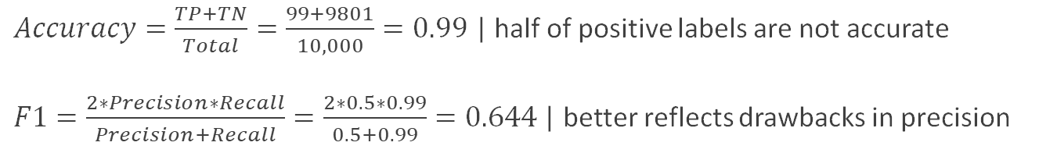
For a low prevalence disease, a high sensitivity and specificity does not always imply good performance. Important to rely on a balanced metric like F1-score​
​
99% specificity with 1% prevalence can result in 1:1 ratio of FP to TP (maximum precision of 50% even with excellent recall)
​ | ​ | User Annotation (Ground Truth)​ |  | ​
​ | ​ | Fracture​ ⊕​ | No Fracture​ ⊖​ | ​
LLM Output​ | Fracture​ ⊕​ | True Positive (TP)​ 99 | False Positive (FP) 99​ | Positive Predictive Value/Precision (PPV)​​ 50%
 | No Fracture​ ⊖​ | False Negative (FN) 1​ | True Negative (TN)​ 9801 | Negative Predictive Value (NPV)​ 99.9% ​
​ | ​ | Sensitivity/Recall​ 99% | Specificity​ 99%​ | ​
$Accuracy=\frac{TP+TN}{Total}=\frac{99+9801}{10,000}=0.99$ | half of positive labels are not accurate
$F1=\frac{2∗Precision∗Recall}{Precision+Recall}=\frac{2∗0.5∗0.99}{0.5+0.99}=0.644$| better reflects drawbacks in precision

Slide 37
Area under the receiver operator characteristic curve (AUC-ROC) measures ability to separate positive/negative cases across all thresholds
Area under the precision-recall curve (AUC-PR) measures FP/FN costs across all thresholds
Threshold​ | TP​ | FP​ | TPR​ | FPR​
0.99​ | 20​ | 0​ | 0.20​ | 0.00​
0.90​ | 50​ | 5​ | 0.50​ | 0.0005​
0.70​ | 99​ | 99​ | 0.99​ | 0.01​
0.50​ | 99​ | 99​ | 0.99​ | 0.1​
0.01​ | 100​ | 9900​ | 1.00​ | 1.00​
Threshold​ | Precision​ | Recall​
0.99​ | 1.00​ | 0.20​
0.90​ | 0.91​ | 0.50​
0.70​ | 0.50​ | 0.99​
0.50​ | 0.50​ | 0.99​
0.01​ | 0.01​ | 1.00​
A high AUC-ROC can suggest excellent separation between classes, but still hide a low precision for a low prevalence diagnosis
The balanced AUC-PR metric exposes the drawbacks of a low PPV (high rate of FP) for a low prevalence diagnosis

Slide 38
SOFTWARE FRAMEWORKS

Slide 39
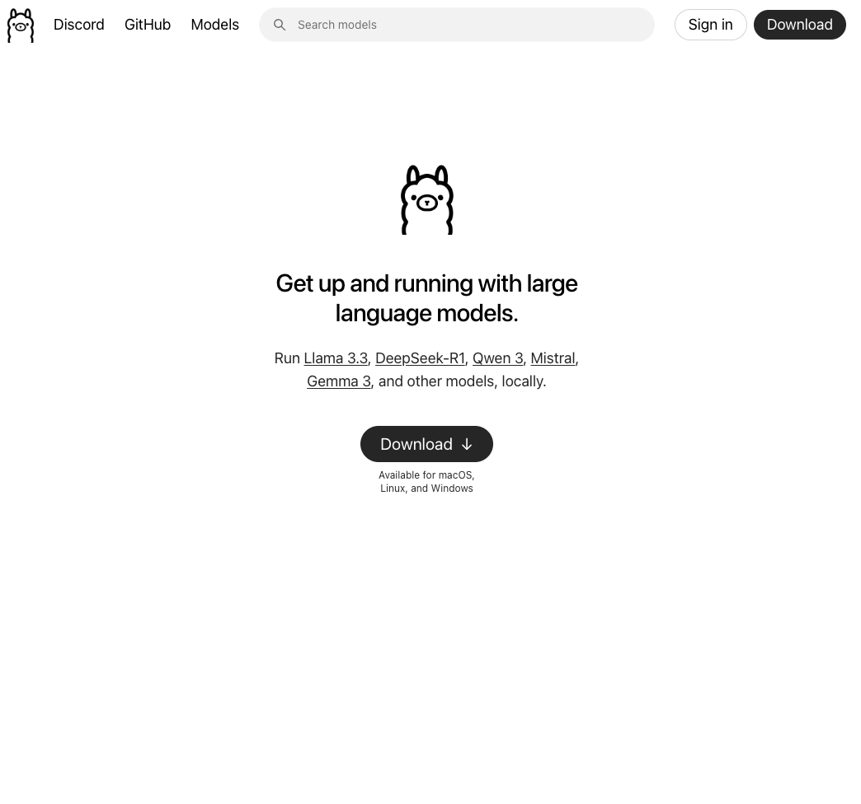
Ollama
https://ollama.com
Easy deployment of models​
Install​
Linux - commandline code​
MacOS – homebrew​
Win – executable or commandline within WSL

Slide 40
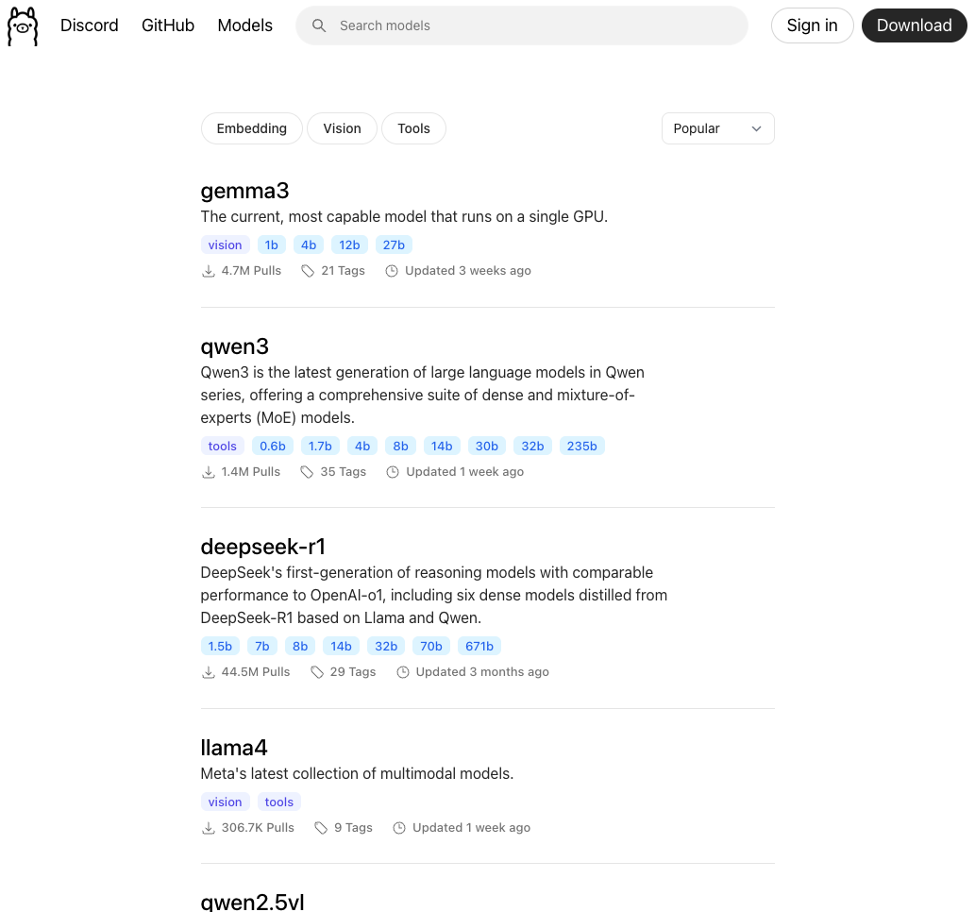
Ollama Repository
https://ollama.com/search
Vast repository of open-source models
Pay attention to:
# of parameters
Size in GB
Receny

Slide 41
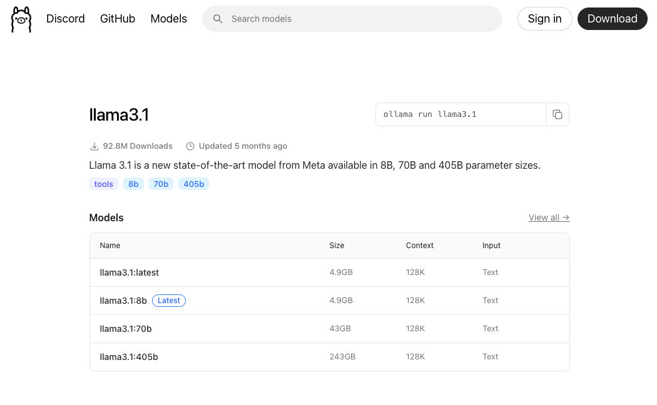
Ollama Models
Pay attention to informational materials below
Understand the message template model expects
Extras
Images
Tools

Slide 42
Ollama up and running
nmc@mac ~ % brew install ollama​
...​
​
nmc@mac ~ % ollama run phi4-mini​
>>> Send a message (/? for help)​
​
​
nmc@mac ~ % ollama list​
NAME ID SIZE MODIFIED ​
qwen3:8b e4b5fd7f8af0 5.2 GB 23 hours ago ​
cogito:8b 75b508ddece1 4.9 GB 23 hours ago ​
phi4-reasoning:latest 47e2630ccbcd 11 GB 23 hours ago ​
phi4-mini-reasoning:latest 3ca8c2865ce9 3.2 GB 24 hours ago ​
phi4-mini:latest 78fad5d182a7 2.5 GB 24 hours ago ​
llama3.2:3b a80c4f17acd5 2.0 GB 40 hours ago ​
llama3.1:8b 46e0c10c039e 4.9 GB 10 days ago ​
llama4:scout b62dea0de67c 67 GB 11 days ago ​
gemma3:27b a418f5838eaf 17 GB 2 weeks ago ​
cogito:14b d0cac86a2347 9.0 GB 5 weeks ago ​
cogito:70b 8f2632d0faa4 42 GB 5 weeks ago ​
gemma3:latest c0494fe00251 3.3 GB 8 weeks ago ​
qwen2.5-coder:32b 4bd6cbf2d094 19 GB 2 months ago ​
deepseek-r1:70b 0c1615a8ca32 42 GB 3 months ago ​
deepseek-r1:14b ea35dfe18182 9.0 GB 3 months ago ​
phi4:latest ac896e5b8b34 9.1 GB 4 months ago ​
llama3.2-vision:90b d2a5e64c56a9 54 GB 4 months ago ​
llama3.3:latest a6eb4748fd29 42 GB 4 months ago ​
deepseek-coder-v2:latest 63fb193b3a9b 8.9 GB 7 months ago ​
​
Basic Commands​
ollama pull llama3.3​
Downloads a new model onto your local machine​
ollama list​
Shows the models you have locally​
ollama run llama3.3​
Runs the local model as an interactive prompt on your machine

Slide 43
LangChain
LangChain is an integrated framework for language model applications.
It simplifies consuming multiple language models from variety of sources (Ollama, OpenAI, Gemini etc.
Simplifies
Sftructured LLM output
Memory
Tool calling
Streaming
Supports seamless transitions between different models within workflows.
Enhances data retrieval and validation by connecting to various sources.
Notes:
LangChain is an innovative framework designed to streamline the use of language models in applications. It supports combining multiple models to effectively handle various tasks, offering easy APIs for seamless integration. This flexibility allows users to transition smoothly between different models, enhancing their workflows and improving data retrieval and validation processes.

Slide 44
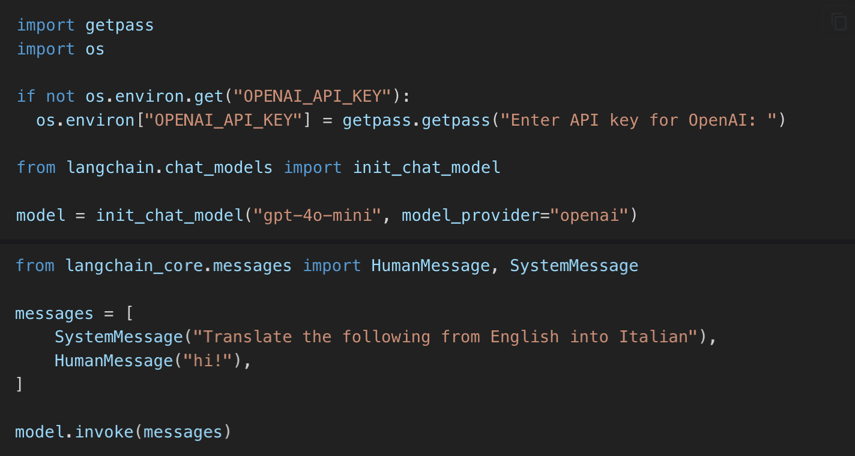
LangChain
Notes:
LangChain is an innovative framework designed to streamline the use of language models in applications. It supports combining multiple models to effectively handle various tasks, offering easy APIs for seamless integration. This flexibility allows users to transition smoothly between different models, enhancing their workflows and improving data retrieval and validation processes.

Slide 45
LangChain
Notes:
LangChain is an innovative framework designed to streamline the use of language models in applications. It supports combining multiple models to effectively handle various tasks, offering easy APIs for seamless integration. This flexibility allows users to transition smoothly between different models, enhancing their workflows and improving data retrieval and validation processes.

Slide 46
ADVANCED CONCEPTS

Slide 47
Advanced Concepts
Tools
Agents
Utilities

Slide 48
LLM Tools
Small units of code that expand the capabilities of an LLM
Search the internet
Code Interpretation
Get current weather
Math
DB Queries
…
Allows a model to interact with an external source of data or perform a task that LLMs are bad at.
Llama Hub https://llamahub.ai/?tab=tools

Slide 49
LLM Agents
An LLM agent is an autonomous reasoning system built on orchestrated LLM calls to make decisions based on available data towards a defined goal and is often enhanced with feedback, memory, and tool integration

Slide 50
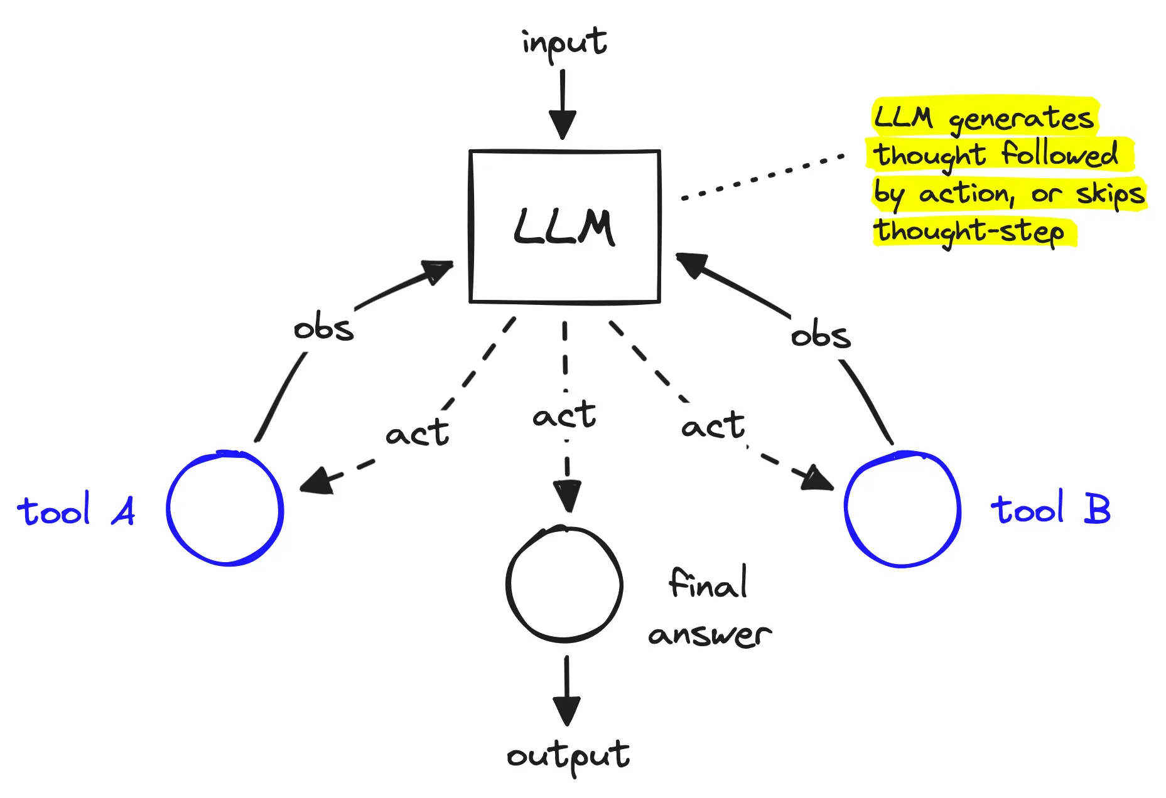
LLM Agents
https://www.pinecone.io/_next/image/?url=https%3A%2F%2Fcdn.sanity.io%2Fimages%2Fvr8gru94%2Fproduction%2F46be5878f4b07b2d259c434dfcceec18e037e404-1857x1272.png&w=3840&q=75

Slide 51
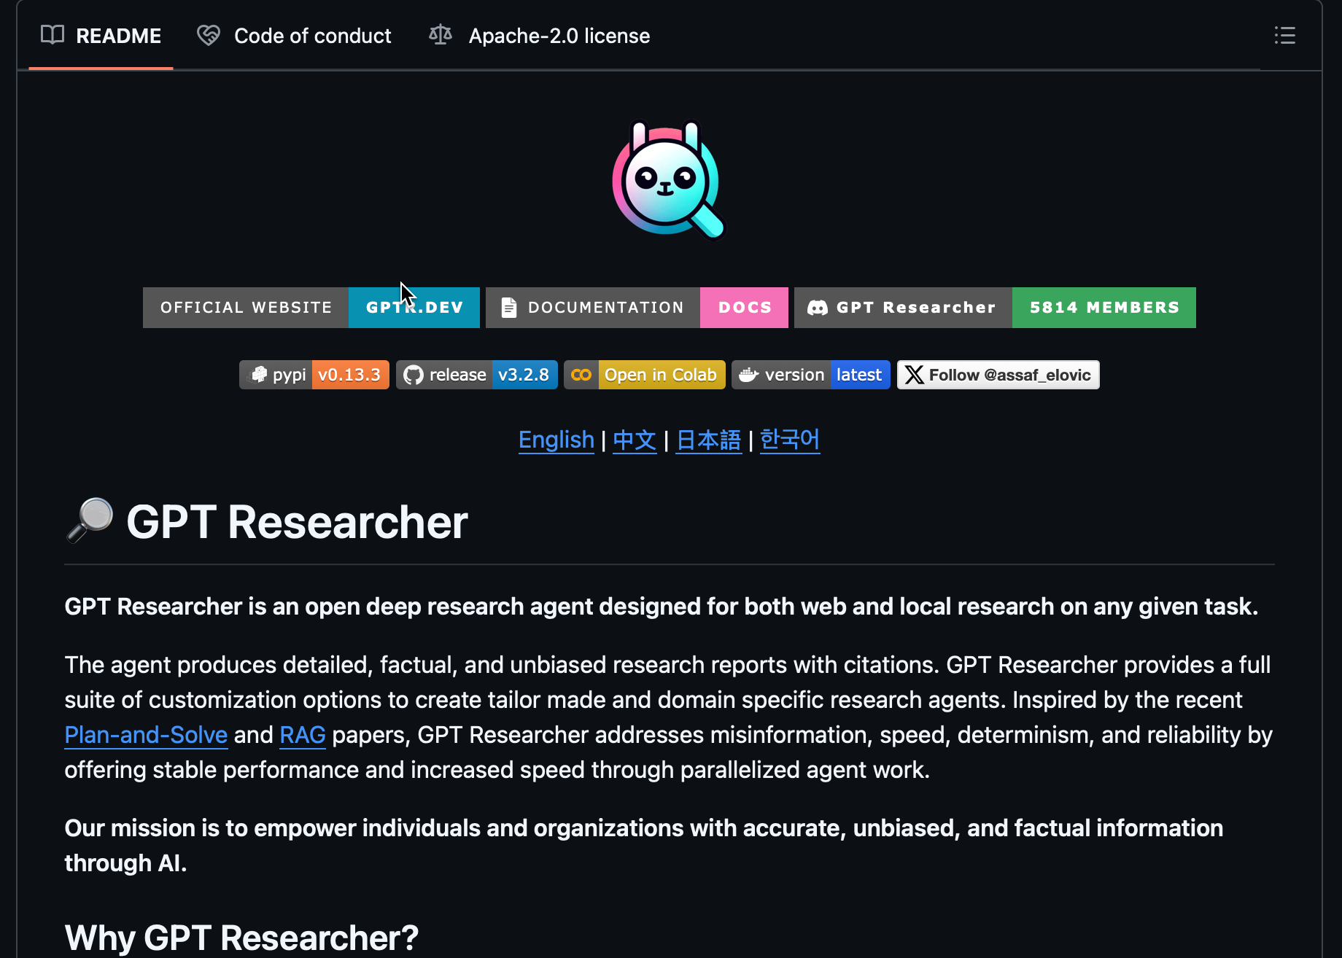
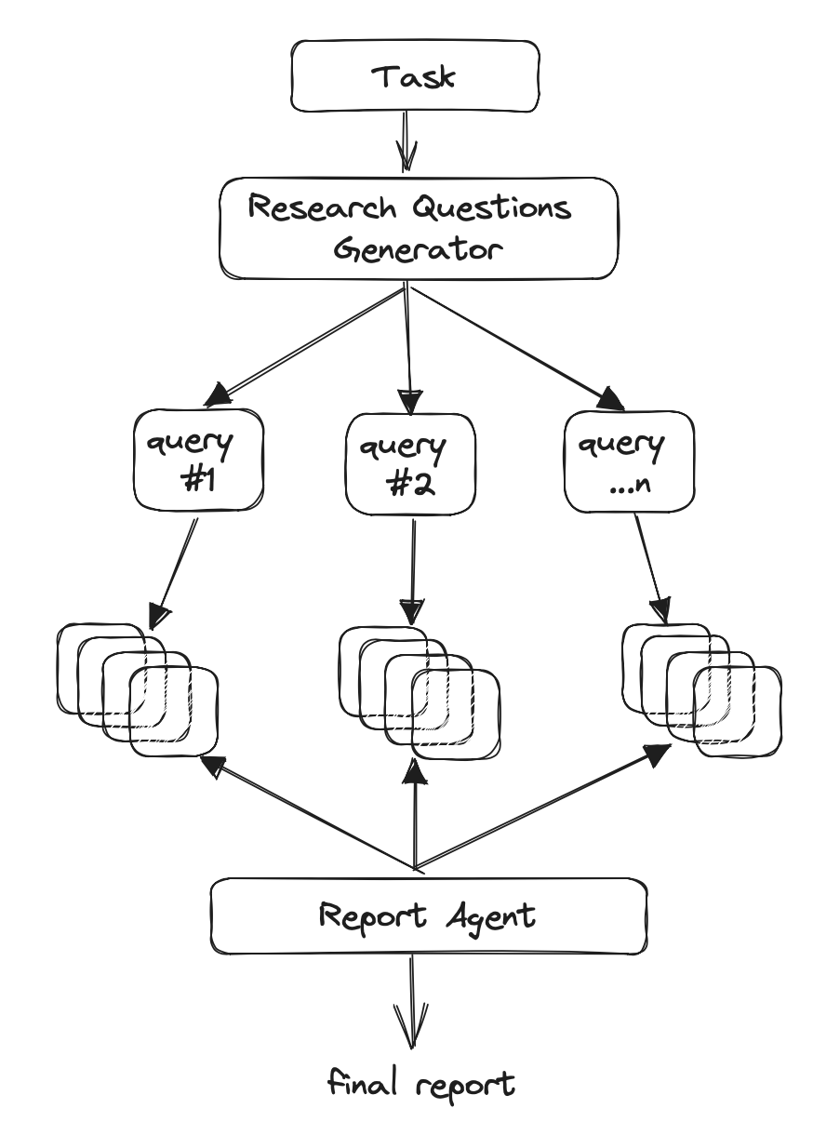
LLM Agents
https://github.com/assafelovic/gpt-researcher https://docs.tavily.com/examples/open-sources/gpt-researcher

Slide 52
Further Reading
Ollama docs - https://github.com/ollama/ollama/tree/main/docs
Llama-Index - https://docs.llamaindex.ai/en/stable/
LangChain - https://python.langchain.com/docs/introduction/
LangGraph - https://langchain-ai.github.io/langgraph/concepts/why-langgraph/

Slide 53

Where are we headed?
Faster, smaller, better LLMs
More powerful hardware
More edge/local LLM usage
Agents for host of interactions
Easier access and operationalization of data
More need for validation and understanding the source of data
Hallucination
Need for focus and guidance on ‘true’ business/clinical problems
https://muralsyourway.vtexassets.com/arquivos/ids/233955/Magic-Crystal-Ball-Wallpaper-Mural.jpg?v=638164873434030000

Slide 54
Utilitarian Command Line Tools
Often need to understand what’s going on, these are useful tools
tmux
htop
glances
nvidia-smi
nvtop
nvitop

Slide 55
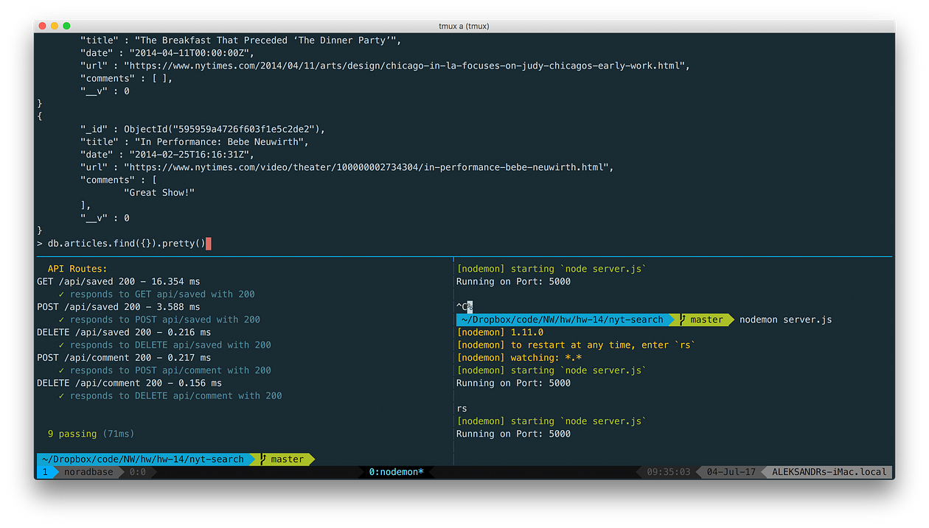
tmux
https://medium.com/@alekshnayder/a-gentle-introduction-to-tmux-8d784c404340

Slide 56
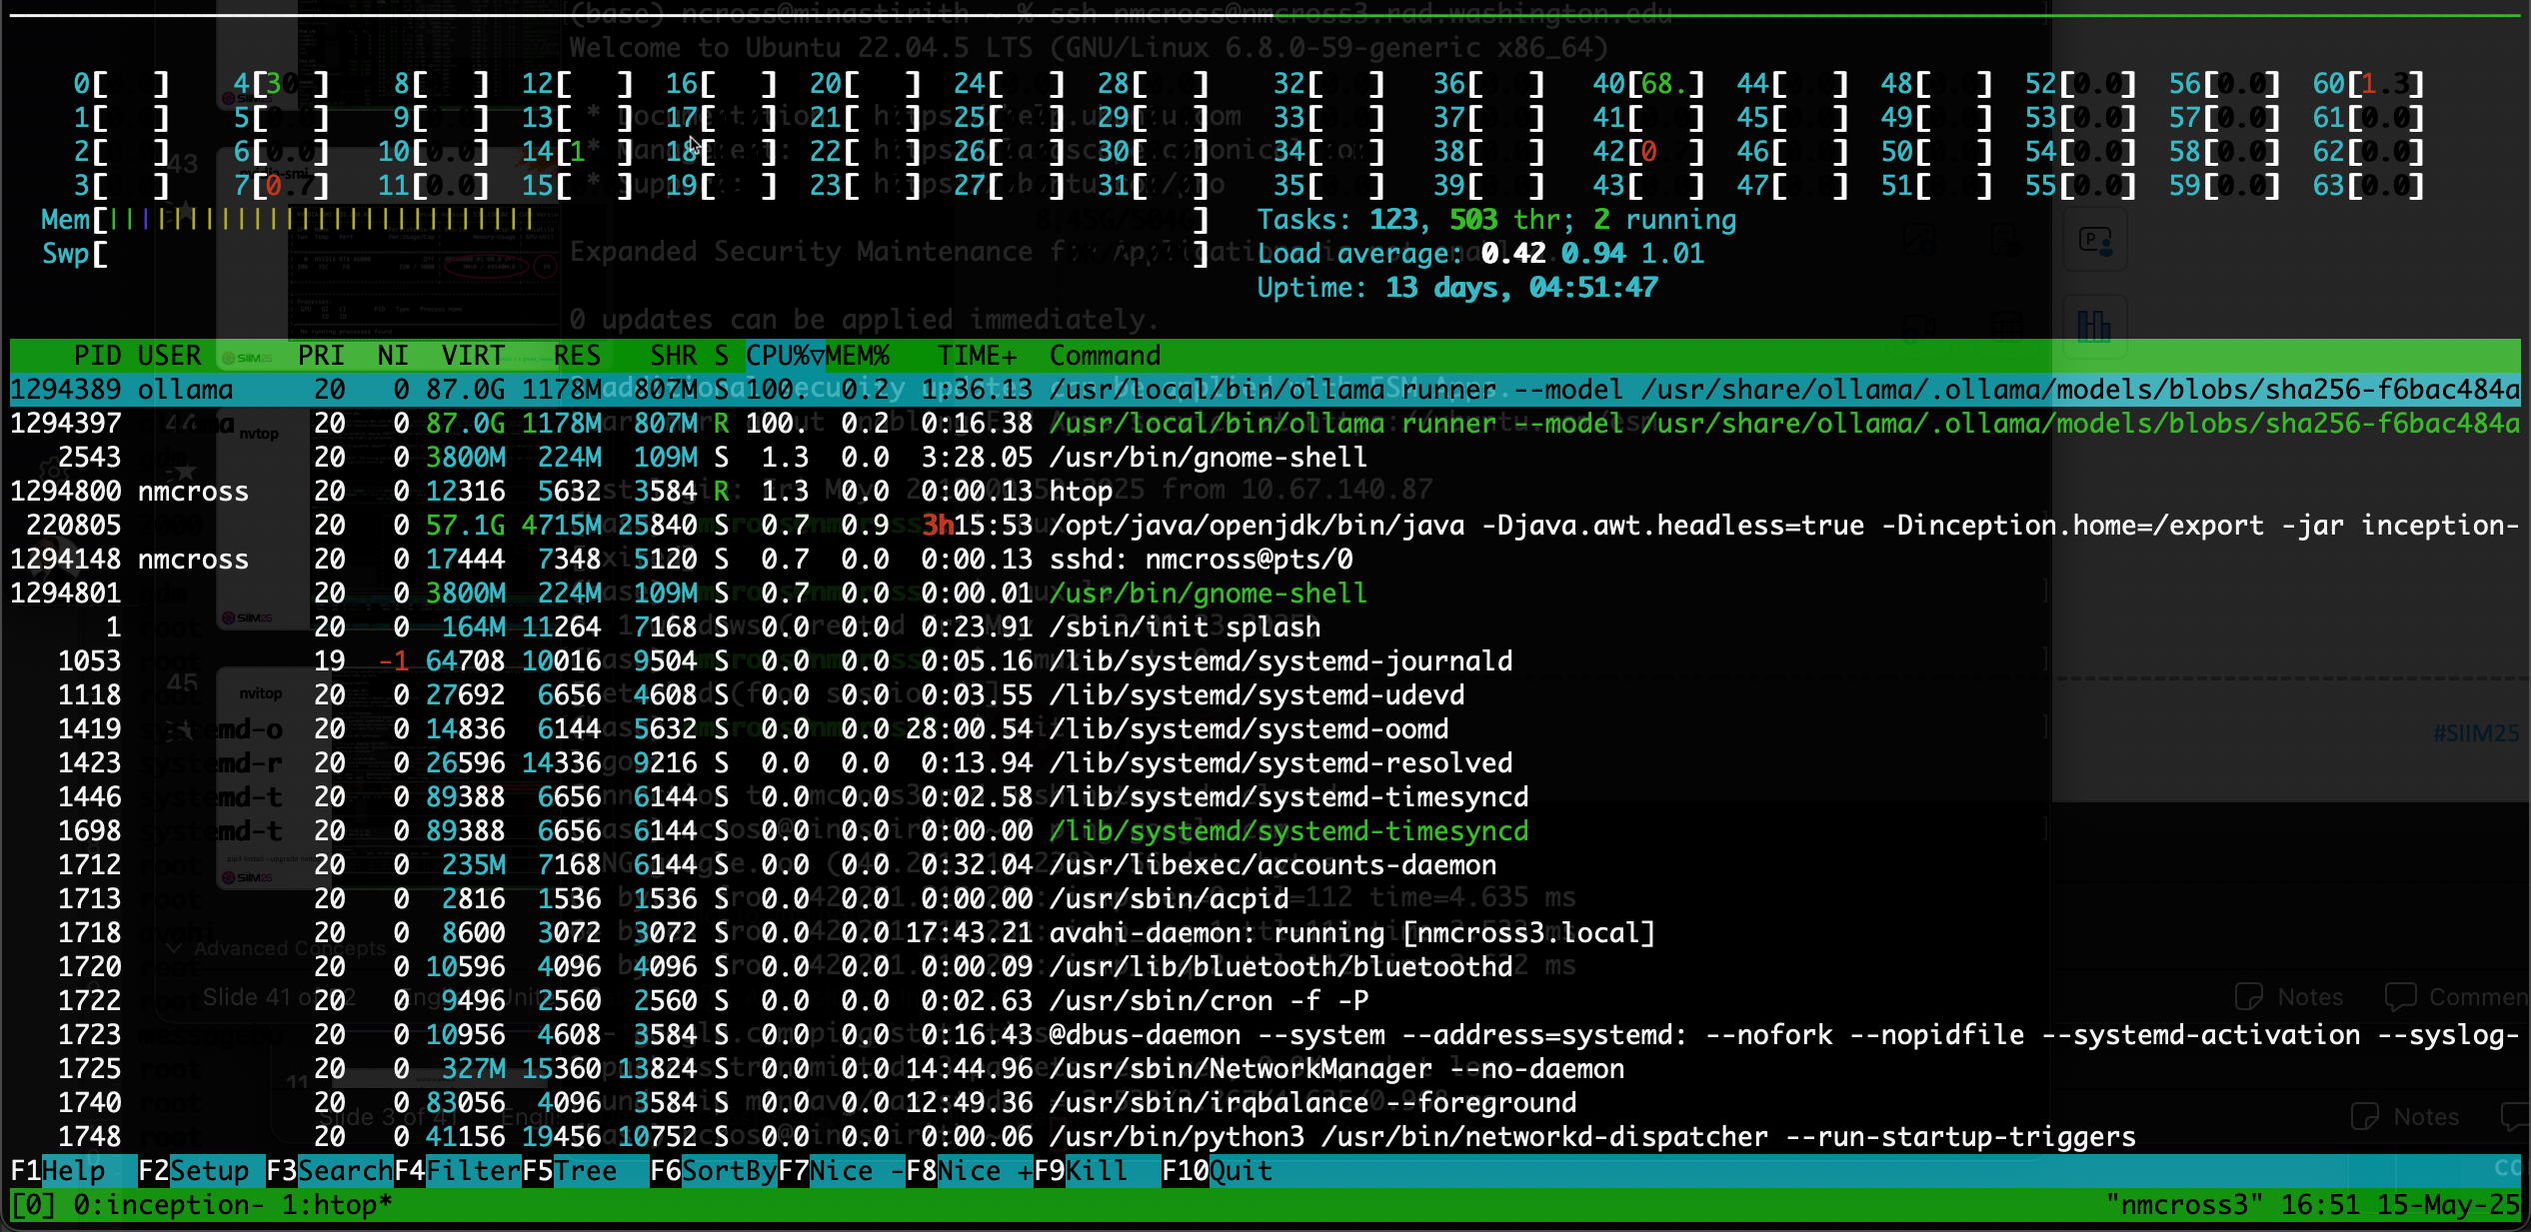
htop

Slide 57
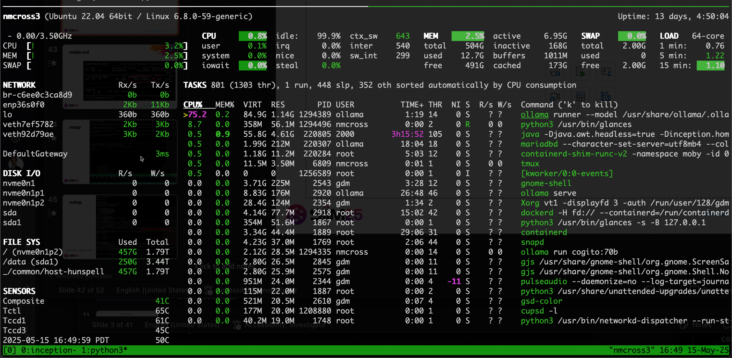
glances

Slide 58
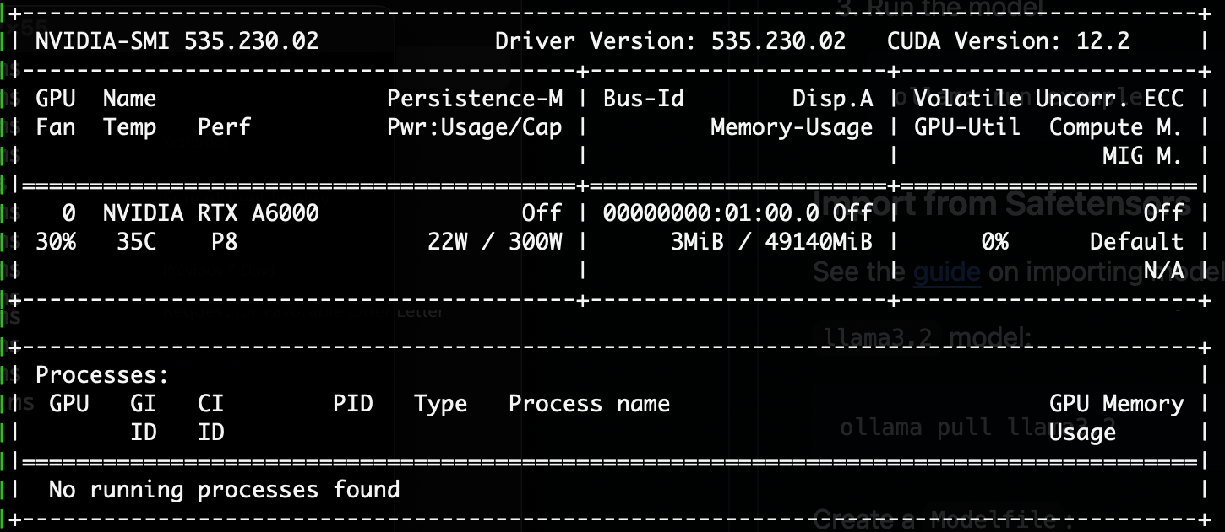
nvidia-smi

Slide 59
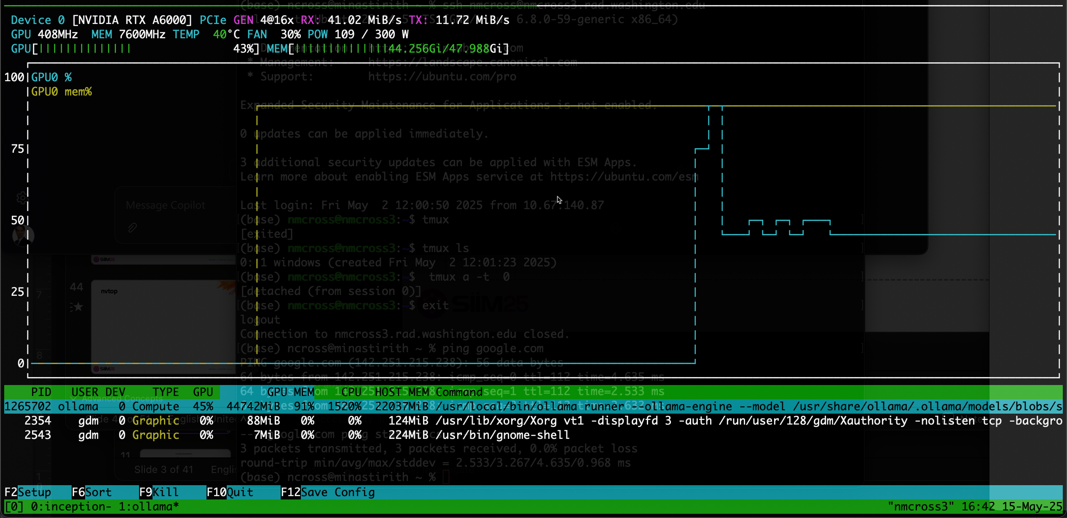
nvtop

Slide 60
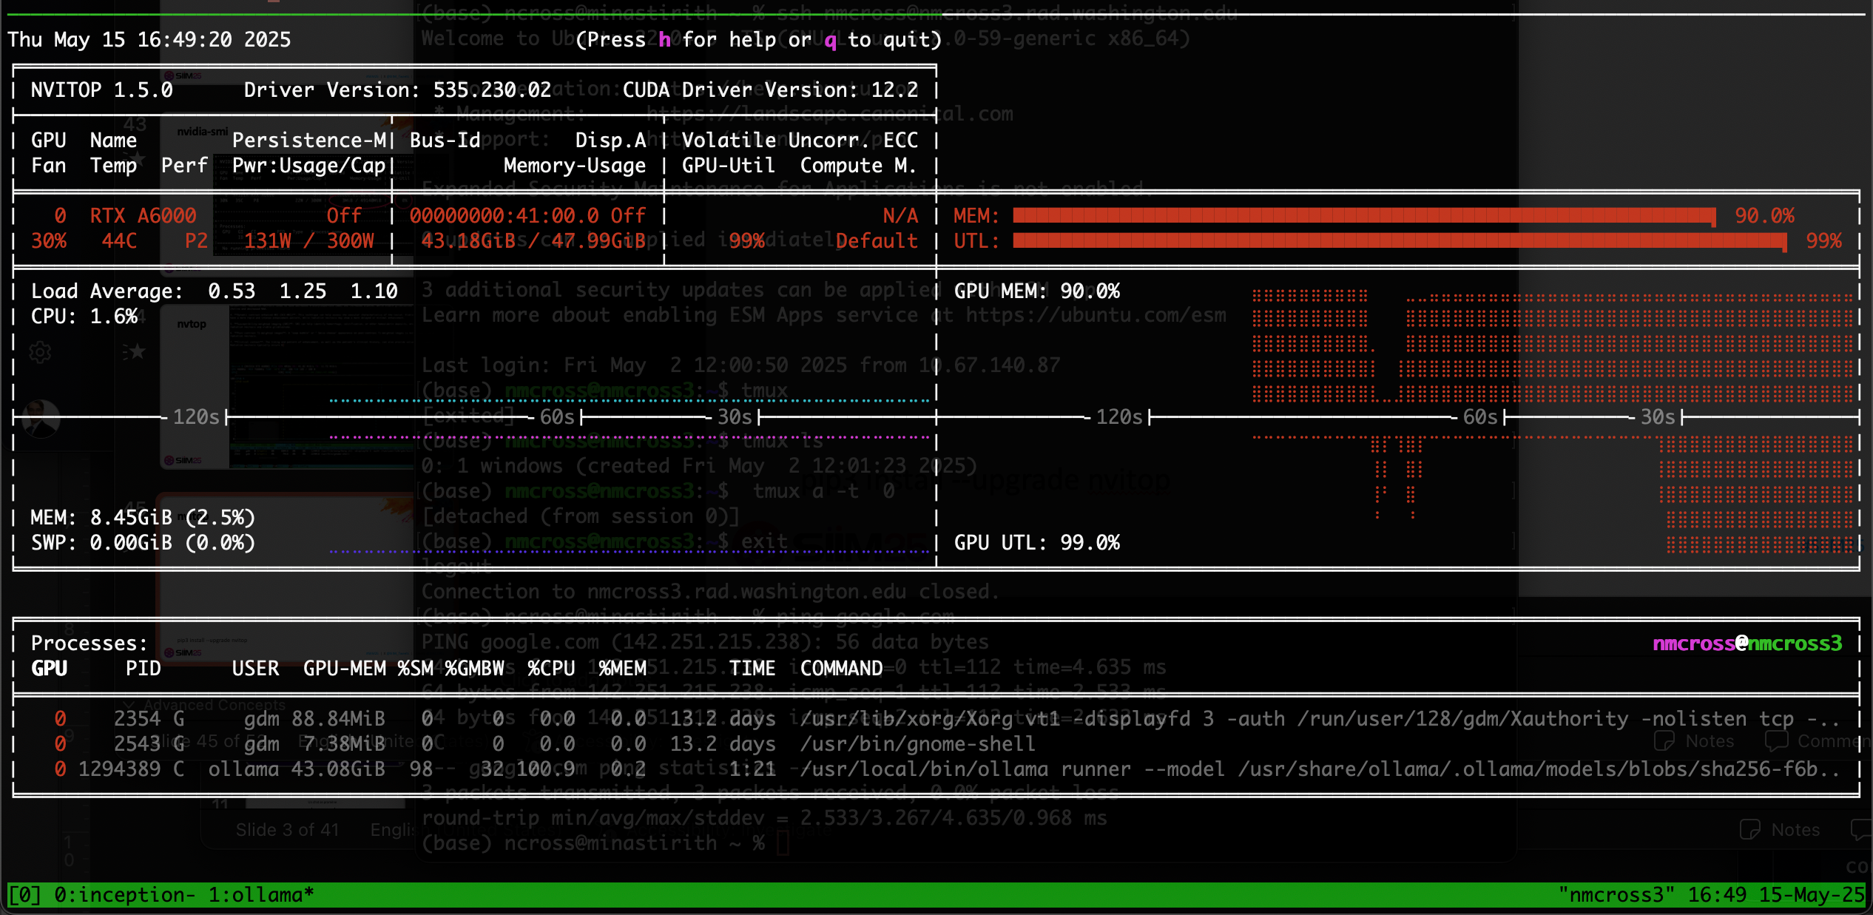
nvitop
pip3 install --upgrade nvitop

Slide 61


Demo!
https://tinyurl.com/y5sudzyf

Slide 62
Challenge!
https://tinyurl.com/y5sudzyf

Slide 63
Challenge Rules
Use report1 dataset, unmodified
Use any model you want
T4 GPU has 14.1Gb so model needs to fit within this
Modify the prompt however you would like
May want to look at misclassified reports for ideas
You need to use at least 10 iterations and report AUC-PR score

Slide 64
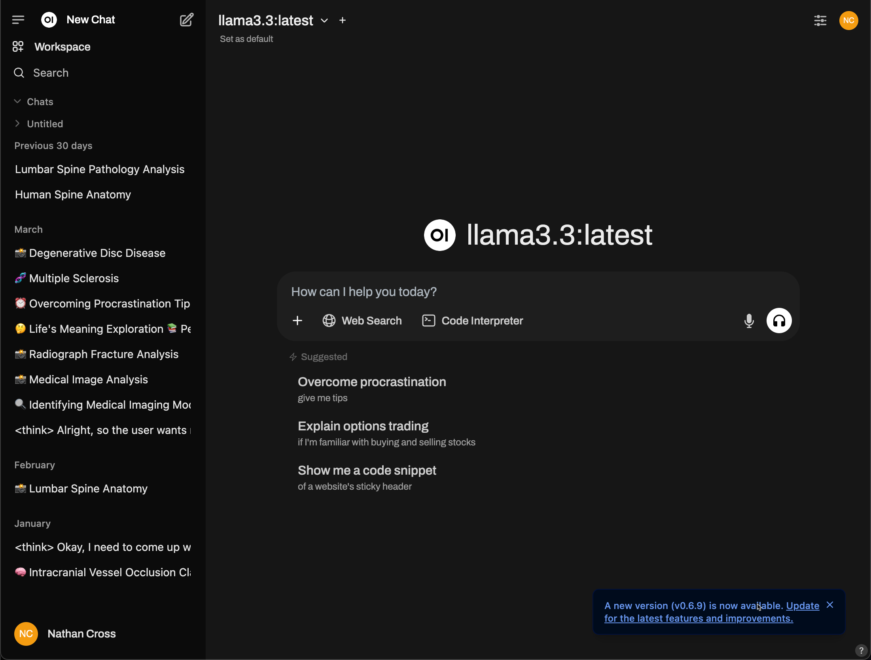
Final Thoughts
OpenWebUI
Open source web UI for interacting with local models and connects to Ollama
https://openwebui.com/

Slide 65
@FINAL SESSION PRESENTER – UPDATE + INCLUDE COMPLETE THE NEXT SLIDE
Participants looking to claim CE must complete a session survey. Attendees claiming RT Credits for this session must enter a verification of attendance code while taking the session survey.
The LAST presenter should update + include the next slide at the end of their presentation. SIIM Staff will distribute these codes closer to the meeting. A list will also be provided in the Speaker Ready Room.
Display on screen PRIOR to Q&A and leave up until “Thank You”
REMOVE THIS SLIDE FROM DECK. NON-FINAL SPEAKERS SHOULD REMOVE THIS + THE CLAIM CREDITS SLIDE.

Slide 66
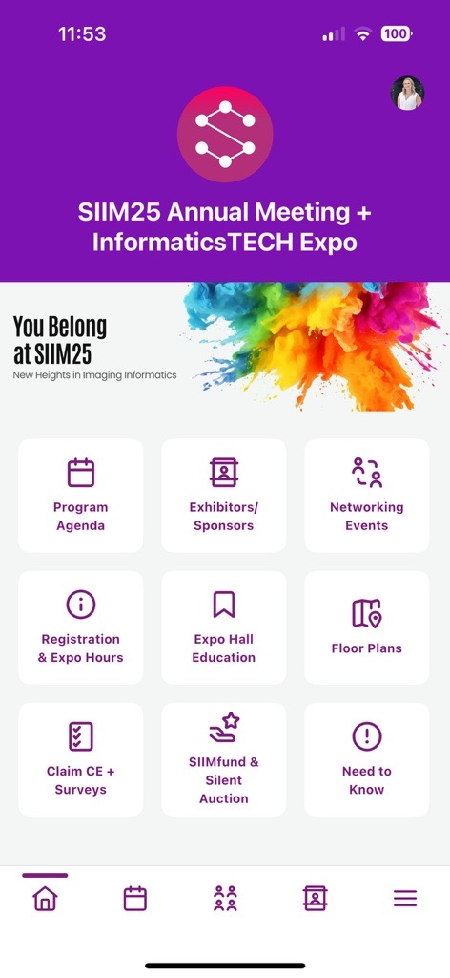
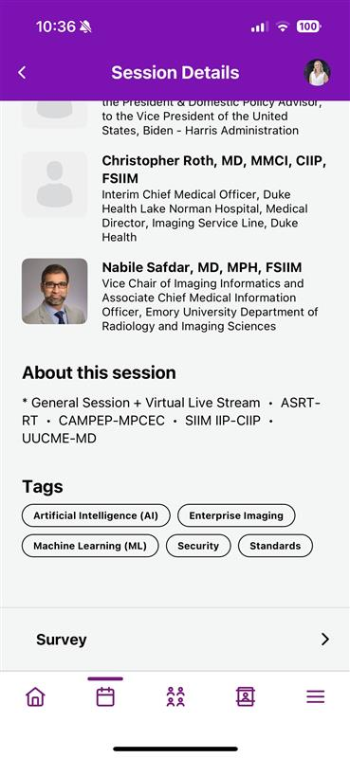
How to claim your CE/CME Credits
Add this session to My Schedule in the Meeting App
Select Claim CE + Surveys
OR select Survey at the bottom of the Session Details page.
Technologists (RT) MUST use code
Complete the survey before June 16
Allow 6-8 weeks for processing
Session ID: 4023
RT Code: 5688

Slide 67
Thank You for Attending!

